Slide 1
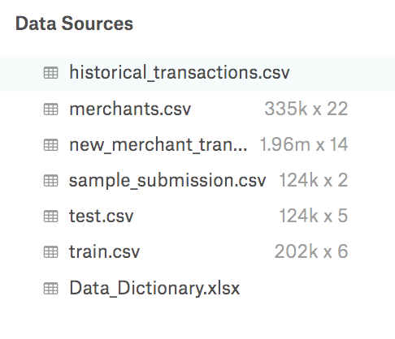
Who wants to win more at Kaggle?
Being able to train an algorithm using unlabeled test data -> more winning at Kaggle!
unlabeled
labeled
Notes:
Who wants to win more at Kaggle?

Slide 2
Why care about unsupervised and semi-supervised learning?
Getting labeled data is currently a major obstacle to applying machine learning to problems in industry.
Human-generated labels: slow and 💰
Labeling data is a 💩 job
Unsupervised learning could also help with data prep
Identify near-duplicate items
Help identify when there are problems with the data collection (instrument failure, biases)
automate splitting data into maximally disparate training and validation folds
Notes:
Who wants to win more at Kaggle?

Slide 3
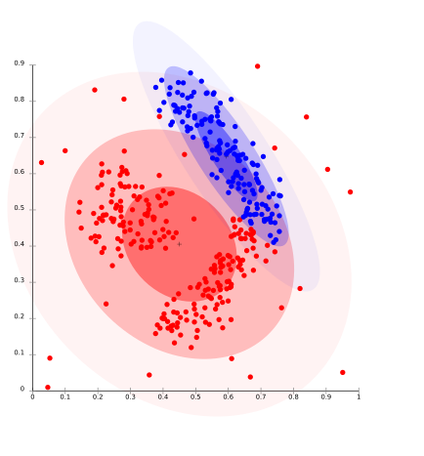

Magic Wand tool for data
What if you only had to label a few clusters and some of the outliers?
Notes:
An interface that allows you to
visualize clusters
hover over individual items to inspect
reassign an item to another cluster

Slide 4
Current problems with autoencs, GANs
Common Knowledge: Autoencoders don’t seem to help with (pre)training classifiers. (but why? Do autoencoders reward a preoccupation with irrelevant patterns? With noise?)
Autoencoders don’t make sense when features have different units or are mixed types (eg continuous, categorical)
GANs don’t generate a mapping of an item to a latent space (the encoder predicts fake or not) - but maybe the latent vector is useful?

Slide 5
Things I don’t like about other semi-supervised methods
All of them seem to rely on having a set of human-defined augmentations that preserve the labels
Eg MixMatch https://arxiv.org/abs/1905.02249
https://arxiv.org/abs/1807.06653

Slide 6
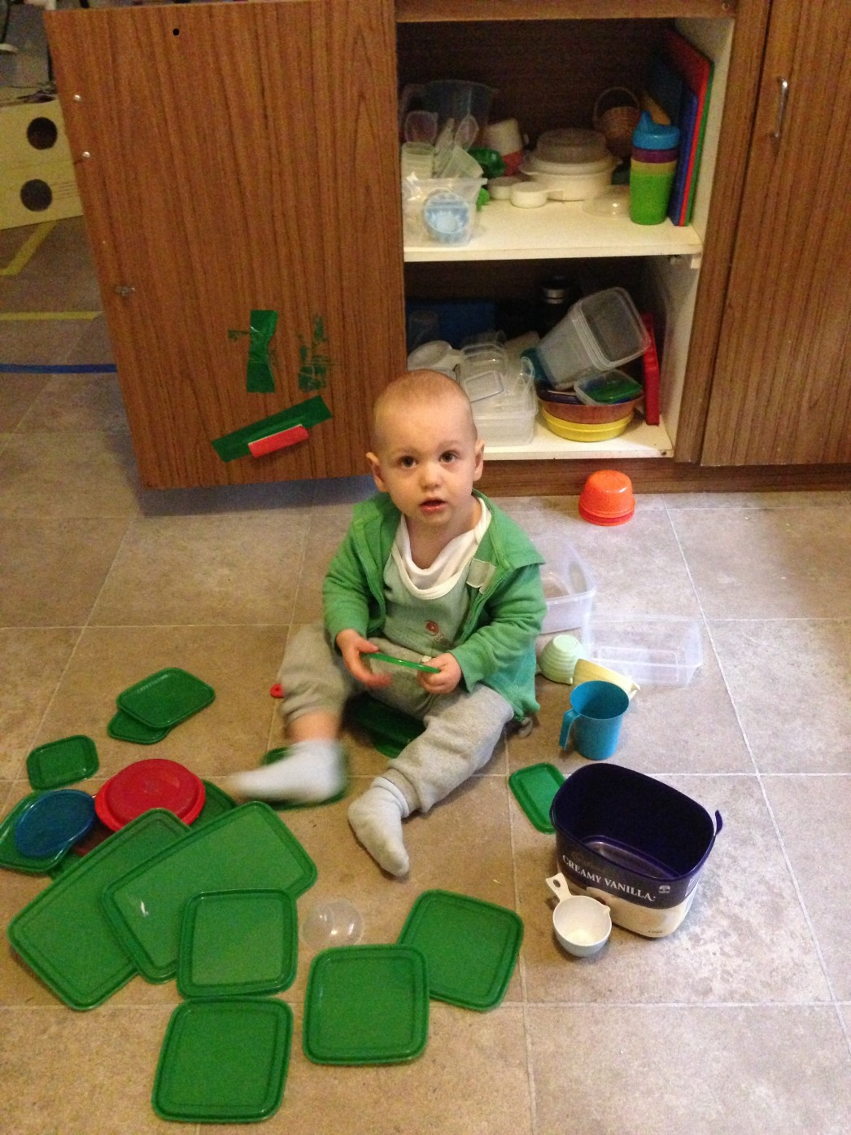
Unsupervised learning
Unsupervised learning is a super juicy technical problem that even toddlers can solve.
Some of these lids are green! Some of these lids are red!
Some of these lids are round! Some of these lids are square!
Some of these containers even fit onto my head!
Notes:
If we limit ourselves to processes that are restricted to a single moment in time (ie no reinforcement learning) being able to group concepts by their similarities and differences - and to (creatively) define those similarities and differences is what intelligence is all about.
Like a bird on a wire
Like a drunk in midnight choir,
I have tried, in my way,
To be free.
I

Slide 7

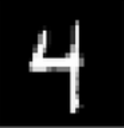
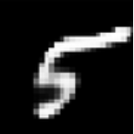
Unsupervised siamese triplet
AKA “The algorithm is always right”
X_{i}
X_{j}
X_{k}
E = encoder NN
M = dense NN with n=3 softmax output
y_{pred}= M(|E(X_{j}) - E(X_{k})|, |E(X_{i}) - E(X_{k})|, |E(X_{i}) - E(X_{j})|)
{
dropout
dropout
dropout
E
example prediction
y_{pred}= [0.22, 0.34, 0.44]
implies
E(X_{i})
| - |
| - |
| - |
M
y_{target} = [0, 0, 1]
Notes:
Train like a toddler: “you’re putting your banana in your hair? Yes! It’s absolutely a good idea to put banana in your hair.”

Slide 8
Aug-supervised siamese triplet
X_{i}
X_{j}
Aug(X_{i})
Training data with ⅛ of the trios labeled with augmented pairs was sufficient for E to learn a sensible-looking representation of the MNIST digits in the latent space.
E(X_{i})
| - |
| - |
| - |
M
y_{target} = [0, 1, 0]
Notes:
https://arxiv.org/abs/1807.06653 - also requires augmentation

Slide 9
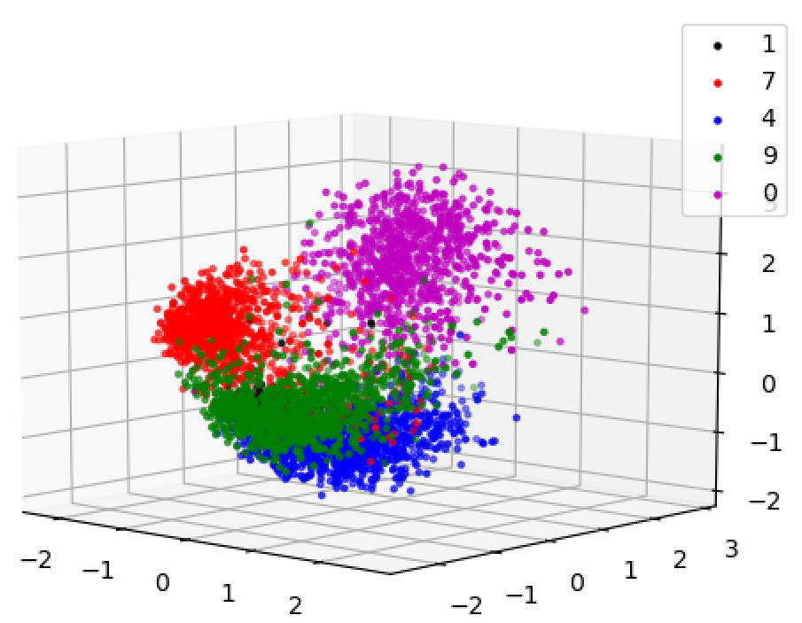
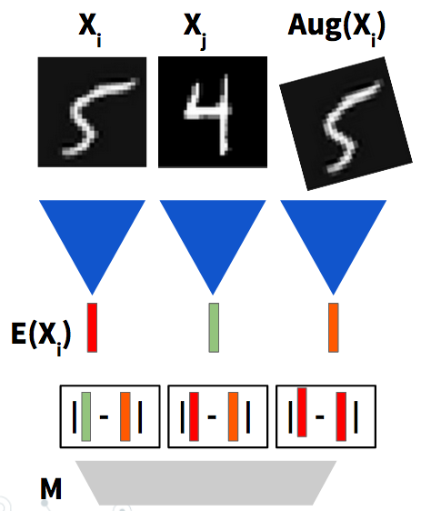
Aug-supervised siamese triplet
AKA “The algorithm is (almost) always right”
⅛ of the training data trios are (X_{i}, X_{j}, A(X_{i})) and the remainder are (X_{i}, X_{j}, X_{k})
Full disclosure: lots of hyperparameter tuning to make the results this pretty (number of neurons per layer, size of latent space, fraction of labeled training data)

Slide 10
Philosophical crisis
Is it possible to build a classifier that is made entirely of discriminative (encoder) components without any generative components?
For image data, defining spatial augmentations can be done intuitively. But other augmentations (a fat pen vs a thin pen) are not intuitive or applied to each pixel uniformly in the way that shearing, rotations and translations are. And how do you define augmentations for tabular data??
X_{i}
X_{j}
Aug(X_{i})
E(X_{i})
Notes:
Small rotation preserves classification
thin->fat pen preserves classification

Slide 11
Augmentation as a variational step in the latent space
If we have a nice, information-theoretically efficient encoder, E, then we can think of augmentations as resulting in a small step away from 𝝻 = E(X) in the latent space.
X_{i}
X_{j}
This sounds like a variational formulation!
E(X_{i})
E(X_{j}) ~ E(X_{i}) + N(𝝁_{i}, 𝞂_{i})

Slide 12

Contrastive loss does not play nicely with variational methods
The contrastive loss enforces a length scale set by the margin, m.
t=0 if 𝜇_{i} and 𝜇_{j} are meant to represent the same item
t=1 if 𝜇_{i} and 𝜇_{j} are not meant to represent the same item
Notes:
There should be an information theoretic justification for a good loss.
Should sigmas be included in the non-variational part of the loss?

Slide 13
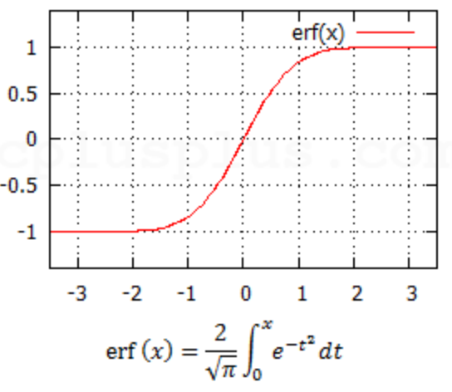
Voila, le Gaussian Overlap loss
The contrastive loss should look more like a cross-entropy loss
Voila, the Gaussian Overlap loss:
|𝜇_{i} - 𝜇_{j}| is always positive
Is there an information theoretic way to derive a loss based on erf(|𝜇_{i} - 𝜇_{j}|)? ie why not erf(|𝜇_{i} - 𝜇_{j}|²)?
Notes:
There should be an information theoretic justification for a good loss.
Should sigmas be included in the non-variational part of the loss?

Slide 14
Voila, le Gaussian Overlap loss
Proposed Gaussian Overlap loss
A better loss should not enforce a length scale.
If the variational term in the loss contains the variational noise parameters, 𝞼 , then 𝞼 would set the length scale. But:
1. calculating this loss would be annoying to parallelize
2. Does this make sense for a variational approach??
… I haven’t tried out the loss with the noise parameters, but probably I should….
Notes:
There should be an information theoretic justification for a good loss.
Should sigmas be included in the non-variational part of the loss?

Slide 15
Encode-Decode-Encode
X_{i}
X_{j}
X_{i}’ = D(E(X_{i}))
Detached from graph
E(X_{i})
E(X_{j})
GO loss target
1
0
0
Minimize:
Maximize:
Maximize:
|E(X_{i}) - E(D(E(X_{i})))|
|E(X_{i}) - E(X_{j})|
|E(X_{i}) - E(X_{i}’)|

Slide 16
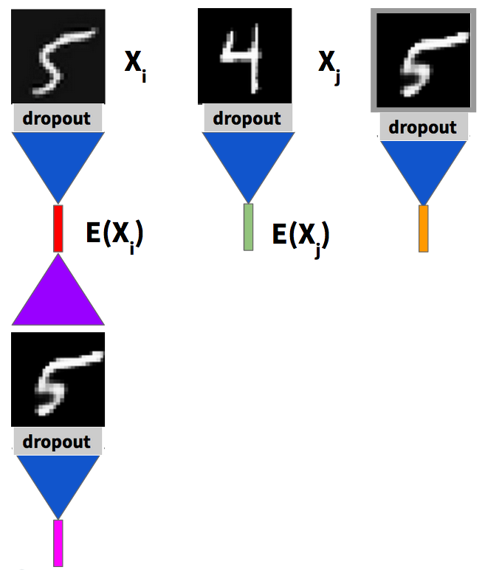
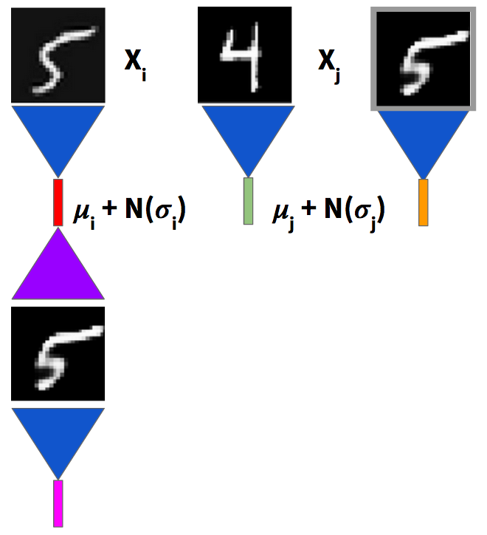
Noise is important for the EDE
Noise from dropout in encoder
2. Noise from variational step
𝜎_{i} , 𝜇_{i} = E(X_{i})
E(X_{i}) = 𝜇_{i} + N(𝜎_{i})
Getting an EDE to work with dropout: pretty easy
Getting an EDE to work without dropout and with a variational step at the encoder output: a little fussy
Minimize:
Maximize:
Maximize:
|E(X_{i}) - E(D(E(X_{i})))|
|E(X_{i}) - E(X_{j})|
|E(X_{i}) - E(X_{i}’)|
Notes:
EDE needs noise to work.
Getting an EDE to work with dropout: pretty easy
Getting an EDE to work without dropout and with a variational step at the encoder output: a little fussy

Slide 17
EDE loss with variational terms
5 GO terms in loss
GO loss target
0
1
0
Maximize:
Minimize:
Maximize:
|E(X_{i}) - E(X_{j})|
|E(X_{i}) - E(D(E(X_{i})))|
|E(X_{i}) - E(X_{i}’)|
Variational terms in loss
6.
7.
k(|E(X_{i})|² + 𝞂(X_{i}) - log(𝞂(X_{i}))) k = a hyperparameter
k(|emb|² ) emb = embedding weights

Slide 18
Kiri’s batch trick
Maximize |E(X_{i}) - E(X_{j})|
The algorithm examines every pair of items [i,j] in the batch and tries to push every pair apart in the latent space. This calculation can be done efficiently with torch.matmul
#indices of the elements of a square matrix above the diagonal
tt = np.triu_indices(mb_size, k=1)
adotb = torch.matmul(mu, mu.permute(1, 0)) # batch_size x batch_size
adota = torch.matmul(mu.view(-1, 1, latent_dim), mu.view(-1, latent_dim, 1)) # batch_size x 1 x 1
bdotb = torch.matmul(mu.view(-1, 1, latent_dim), mu.view(-1, latent_dim, 1))
diffsquares = (adota.view(-1, 1).repeat(1, mb_size) + bdotb.view(1, -1).repeat(mb_size,1) - 2 * adotb) / latent_dim
#pick out only the elements above the diagonal
diffsquares = diffsquares[tt]
Maximize sum of diffsquares with GO loss (target = 0)

Slide 19
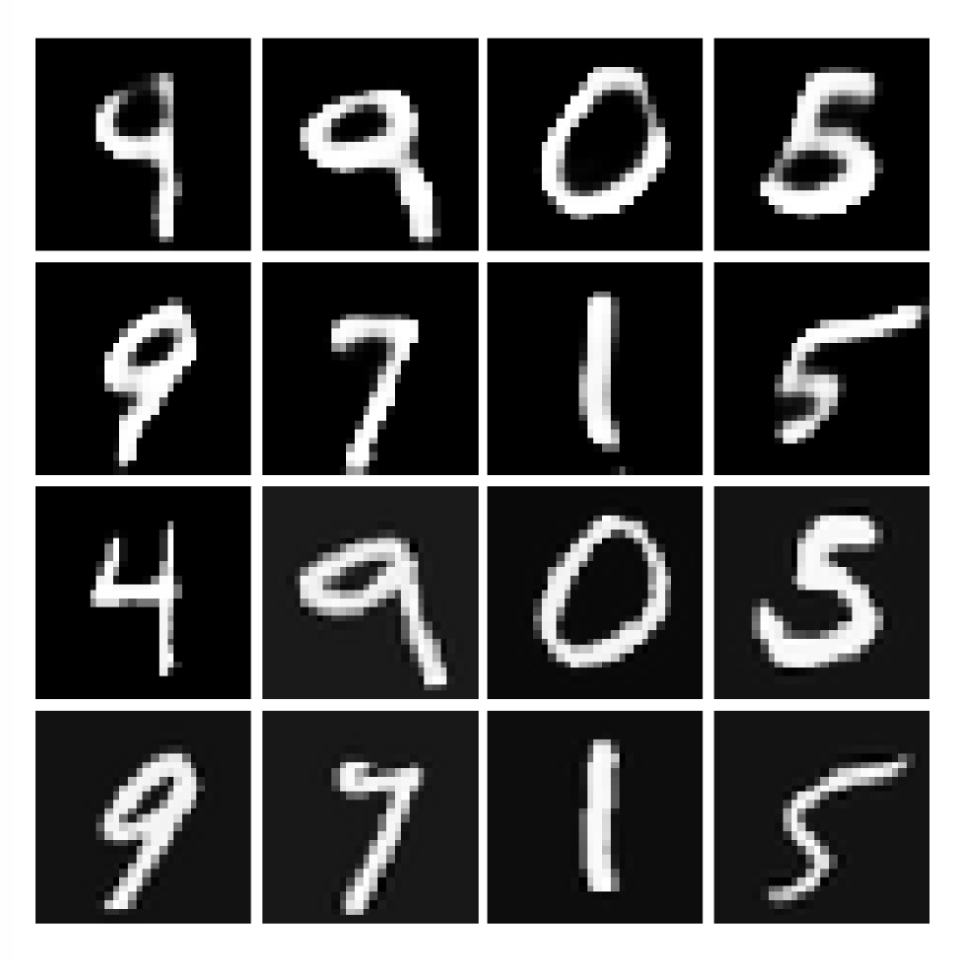
EDE with MNIST data
Batchnorm is a bad idea. Use weightnorm instead
And hey! The MNIST digits look pretty good!
D(E(X))
Original images, X

Slide 20
Encoding structured data
Autoencoders only make sense when all the features have the same units…. but different features have different units!
Features can have values which are continuous, discrete, categorical or text!
Titanic data set:
Categorical: Pclass, Embarked, Sex, Survived, Surname
Continuous: Fare, Age
Embedding for categorical variable with n possible values where the embedding space has dimension ceil(log(n)/log(2)).
Hyperparameter: cutoff for minimum number of times the value occurs in the training set before being given a novel embedding
Encoder: 2 layer convnet with 2 parallel dense layers to calculate 𝜇, 𝜎
Decoder: 2 layer convnet with dense layers before inverse-mapping embeddings

Slide 21
EDE loss with unlabeled data
5 GO terms in loss
GO loss target
0
1
0
Maximize:
Minimize:
Maximize:
|E(X_{i}) - E(X_{j})|
|E(X_{i}) - E(D(E(X_{i})))|
|E(X_{i}) - E(X_{i}’)|
GO loss
target
1
0
4. Minimize:
5. Maximize:
|E([X_{i}, target=missing]) - E(X_{i}, target=y_{correct})|
|E([X_{i}, target=missing]) - E(X_{i}, target=y_{incorrect})|
Variational terms in loss
6.
7.
k(|E(X_{i})|² + 𝞂(X_{i}) - log(𝞂(X_{i}))) k = a hyperparameter
k(|emb|² ) emb = embedding weights
What happens if each item contains a unique piece of information (like a name?) Will weighting the embeddings stop the EDE from zealously pursuing the reward for disambiguating items, while ignoring the discriminator and classification tasks?)

Slide 22
EDE detach step
X_{i}’ = D(E(X_{i}))
Detached from graph
Embedding maps n categorical values to n points in phase space
Predicted target. The algorithm can predict any point in the embedding space - but if the predicted target is not one of the points in the embedding, then discriminator will be tipped off that the feature has been generated!! Is the solution to ‘snap’ predicted categorical and discrete features to the nearest allowed point during the detach step?
But detach_and_snap works worse than just detach!!
It’s so weird that EDE works with
Maximize E((D(E(X))_detach) - E(X) and not
Maximize E((D(E(X))_detach_and_snap) - E(X)
Maybe variational embeddings would blur the points in the embedding space? But what about discrete-valued features? Is the algo using the extra phase space to hide info about whether the item is generated?

Slide 23
EDE with missing data
Encode missing categorical targets as [0,0 … 0]
Two methods to calculate categorical target:
Encode, decode, then pick out the target feature and convert the closest embedding point back to the embedding index.
y_{target} = D(E([X_{i},target=missing]))_{target}
0
1
Disadvantages: no error estimate, error from both decoder and encoder
2
y_{target}
2. Use softmax of Gaussian Overlap to compare encodings of item with missing target to the item with target=y₀ and target=y₁
𝜇_{i,missing} = E([X_{i}, target=missing])
𝜇_{i,0} = E(X_{i}, target=y₀)|
𝜇_{i,1} = E(X_{i}, target=y₁)|

Slide 24
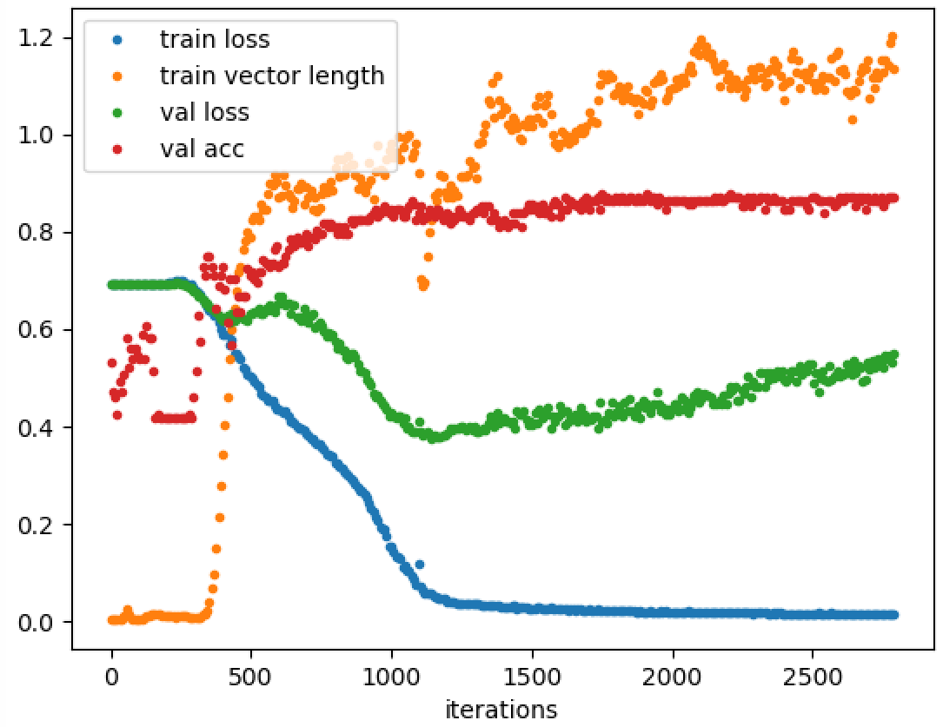
EDE training for Titanic data set
softmax(GO(𝜇_{i,0} - 𝜇_{i,missing}), GO(𝜇_{i,1} - 𝜇_{i,missing}))
D(E([X_{i}, target=missing]))_{target} == X_{i,target}
Two methods to calculate categorical target

Slide 25
EDE training for Titanic data set
Training vector length equilibrates because of competition between GO loss termas and E(X_{i})|² term in loss.
Could you construct an ensemble of networks using network weights after equilibrium is reached?

Slide 26
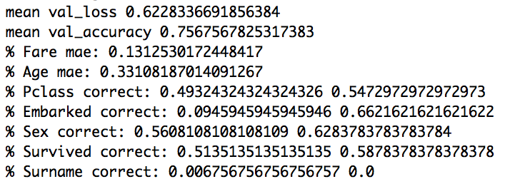
EDE training for Titanic dataset
softmax(GO(𝜇_{i,0} - 𝜇_{i,missing}), GO(𝜇_{i,1} - 𝜇_{i,missing}))
D(E([X_{i}, target=missing]))_{target} == X_{i,target}
Logging reconstruction errors for each feature
Performance on non-target values is better when the algorithm is not reconstructing missing target values.
Is the algorithm using not-target categorical features to hide information about whether the item is a reconstruction? (ie D(E(X)) vs X?)

Slide 27
More EDE mysteries….
RMSprop(momentum=0.5) seems to work better than Adam. SGD doesn't work at all. what's up with that?
PReLU vs LeakyReLU: turning off noise generated for items with missing targets 𝜇_{t=mis} makes NAN losses for LeakyReLU but not for PReLU?
PReLU seems to allow the algorithm to learn representations for 𝜇_{t=mis}, 𝜇_{t=0}, 𝜇_{t=1} such that |𝜇_{t=mis}-𝜇_{t=0}| and |𝜇_{t=mis}- 𝜇_{t=1}| have different values for all the items. Meanwhile LeakyReLU seems to cause the algorithm to learn representations such that |𝜇_{t=mis}-𝜇_{t=0}| and |𝜇_{t=mis} - 𝜇_{t=1}| have THE SAME VALUES for all the items... What!!! Is this just a result of having a shallow network?
How to pick constant for variational terms in loss?
6.
7.
k(|E(X_{i})|² + 𝞂(X_{i}) - log(𝞂(X_{i}))) k = a hyperparameter
k(|emb|² ) emb = embedding weights

Slide 28
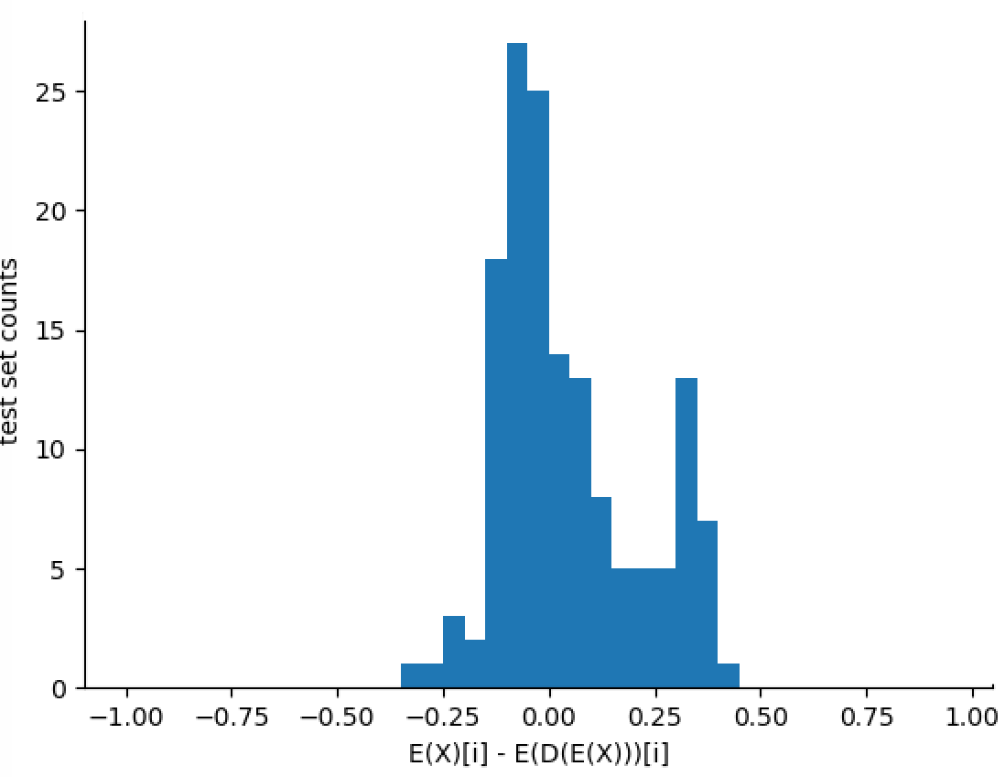
EDE further work: how does algo store real vs generated?
Does the algorithm “hide” information about whether the item is reconstructed? (ie by using a non-information feature to stash “this is a fake”)
Once the EDE is “good enough” does it just stop encoding whether the item looks faked?
Is the algorithm making a “swiss cheese” latent space where the bubbles are fakes and the solid bit is items from the training set?
Are the distributions of 𝜎’s are different for real and generated items?

Slide 29
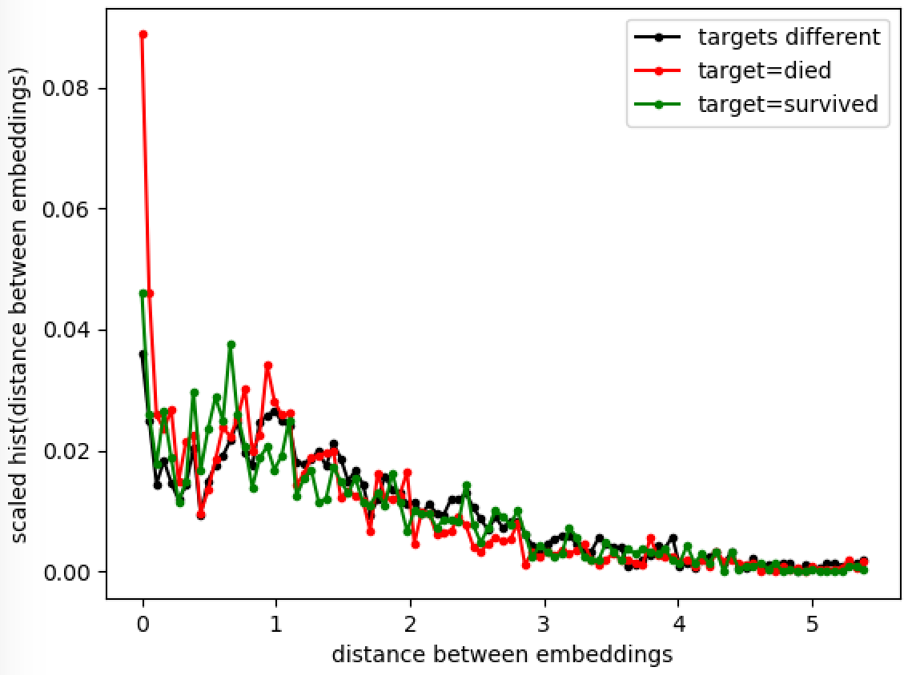
What is the EDE doing? It’s not clustering items by label...
There isn’t a cluster for each target….
Maybe there is a way to do a dot product between 𝜇_{i} and a ‘meaning’ vector that will pick out different kinds of labels. (consider MNIST: digit label, but also, pen width)

Slide 30
Back to the unsupervised siamese triplet
X_{i}
X_{j}
X_{k}
{
dropout
dropout
dropout
E
Can I use 3 GO losses instead of 3 contrastive losses or M and binary logloss?
Would this eliminate needing trios with augmented pairs for training?
E(X_{i})
| - |
| - |
| - |
M

Slide 31
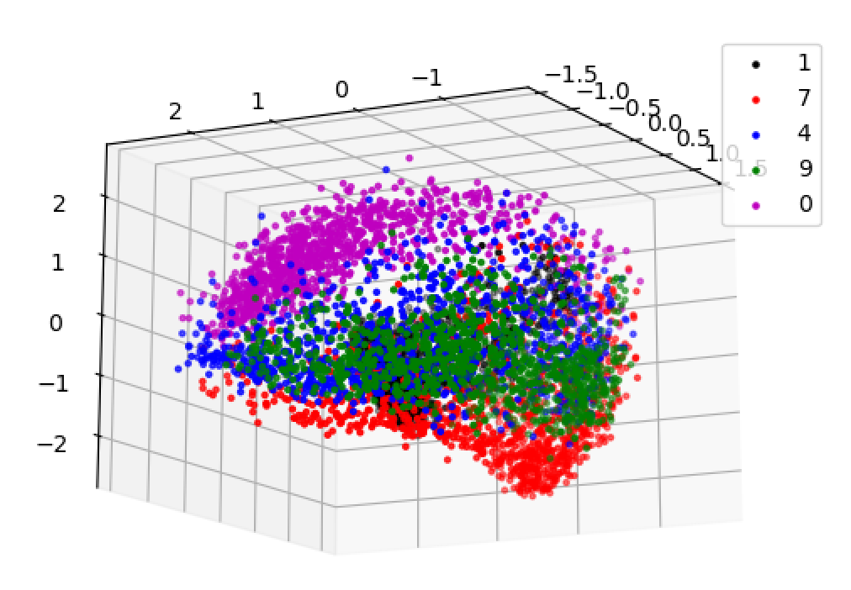
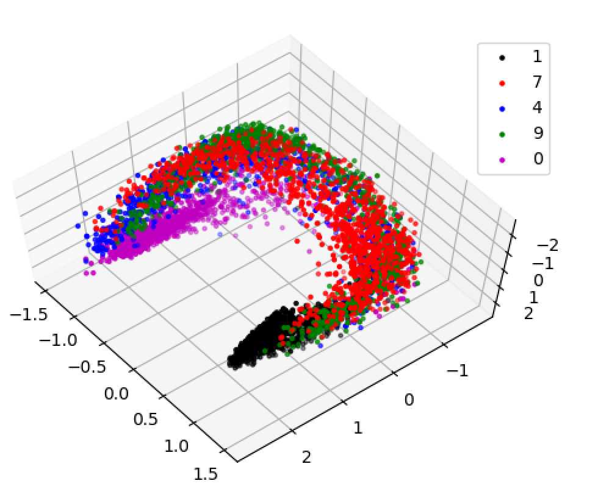
Variational siamese triplet
X_{i}
X_{j}
X_{k}
{
E
E(X_{i})
| - |
| - |
| - |
3 Gaussian Overlap losses with “the algorithm is always right”
What’s up with the PCA horseshoe? (digit tilt?)
Notes:
Don’t know where the horseshoe came from in the distribution of points. (PCA’ed the 32 dim latent space down to 3 dims)

Slide 32
EDE further work
Why does the algorithm not work better when the discrete/categorical features in D(E(X))_{detach} are not “snapped” back to points in the embedding space?
Is there an information-theoretic justification for using the Gaussian Overlap loss?
Non-euclidean embeddings?
Does there need to be a mechanism to introduce noise at different levels in the encoder? (ie not just at the last step)
Create label-preserving combinations of embedding vectors: D(0.1*E(X_{a}) + 0.9*E(X_{b})) should have the same target label as X_{a} and X_{b}. What about D(1.37*E(X_{a}) - 0.37*E(X_{b}))?

Slide 33
EDE further work: deep networks
Current version for tabular data uses wide 2-layer convnet. Yuck. I expect this will start to be problematic for large numbers of features.
So I need to build deeper networks.
What is the smart way to construct a deep network?
Is noise enough to keep from overfitting a large network?
Is there a smart way to start with a large network and prune the number of parameters without reducing the expressiveness?
Would a deeper network allow training with detach_and_snap to work?
How to map from a network to a tree/forest model?

Slide 34
EDE further work
Look at test set performance as a function of number of items in the training data that are labeled.
Modify the MNIST EDE to encode digit label
Look at some other tabular data sets other than the Titanic data set.
Build a normalized flow-based version of the EDE

Slide 35
EDE further work: extrapolation
Neural networks are typically good at interpolation and bad at extrapolation.
Unsupervised learning should segment subpopulations in the training data. Would learning augmentations to extrapolate from one training subpopulation to another training subpopulation allow the algorithm to extrapolate to novel test set populations?
What about classifying test set classes that are not in the training set?

Slide 36
EDE further work: anomaly detection
Autoencoders can be used for anomaly detection by looking for items with large reconstruction losses in the original feature space.
Can anomaly detection be done entirely in the latent space without needing to examine the reconstruction loss in the feature space? Are anomalous items encoded to latent vectors with lengths close to 0? (or does the first encoding produce a very long vector while the second encoding produce a very short vector?)

Slide 37
Autoencoder vs EDE vs siamese triplet
Autoencoder: needs a lot of information to encode features which have randomish values for each item (ie algo is rewarded for encoding info that is pretty random)
Triplet/Algorithm Is Always Right: learns to ignore features which have randomish values for each item? But only learns coarse features?
EDE: discriminator task of encoder tends to encourage algo to ignore features which have random values?
GAN variants: does separating the encoder and the discriminator have any advantages over EDE? (ie more sensible embeddings?

Slide 38
Conclusions
Toddlers still have jobs!
Augmentations can be thought of as step N(𝜎) away from the embedding point 𝜇 in the latent space.
Gaussian Overlap loss is an alternative to contrastive loss that can be used with a variational approach.
W Detach_and_snap doesn’t work. Why? Do I just need a deeper network? Is the algorithm using empty parts of the categorical embedding spaces to ‘hide’ information about whether an item is generated?
Decoders force encoders to be better observers. Decoders articulate different kinds of augmentations. Does the Siamese triplet encoder only ever learn coarse features? Maybe you can still have a classifier with only encoders, but perhaps having a decoder task helps the encoder not to overfit?

